Slide 1
Customer Lifetime Value (I): Contractual Settings
Lecture 6
Customer Analytics

Slide 2
Agenda
Conceptual definition & applications
Primitives of CLV
Model 1: geometric model of retention
Model 2: shifted Beta-geometric model of retention
Heterogeneity and increasing retention rates
Calculating CLV/RLV

Slide 3
Customer Lifetime Value
CLV is the present value of the future profits associated with a particular customer

Slide 4
Customer Lifetime Value
CLV is the present value of the future profits associated with a particular customer
Time value of money:
€1 today > €1 tomorrow

Slide 5
Customer Lifetime Value
CLV is the present value of the future profits associated with a particular customer
Uncertain from today’s perspective—
it’s a forecast/prediction!
Time value of money:
€1 today > €1 tomorrow
Notes:
Not past profitability; different models will give you different predictions.

Slide 6
Customer Lifetime Value
CLV is the present value of the future profits associated with a particular customer
Uncertain from today’s perspective—
it’s a forecast/prediction!
Revenues less customer-specific variable costs: marketing, billing, servicing, tech support
Time value of money:
€1 today > €1 tomorrow
Notes:
Customer-specific variable costs: billing, after-sales support,

Slide 7
Customer Lifetime Value
CLV is the present value of the future profits associated with a particular customer
Uncertain from today’s perspective—
it’s a forecast/prediction!
Revenues less customer-specific variable costs: marketing, billing, servicing, tech support
Time value of money:
€1 today > €1 tomorrow
Measured for (ideally) individual customers;
recognize every customer is different
Notes:
Ideally at individual level; what actually happens is at a cohort level – customers who have the same company lifetime, i.e., started the same year.

Slide 8
Two settings
Netflix said it added 7.05 million subscribers during the fiscal 4th quarter. For the quarter, Netflix added 1.93 million memberships in the U.S. and 5.12 million internationally.
Bol.com opened its doors on 30 March 1999. Eighteen years later, the store has more than 7 million active customers* in the Netherlands and Belgium and an assortment of almost 15 million items.
* customers are considered active when they have placed an order during the preceding twelve-month period
Netflix
Bol
Which firm knows better who their customers are?

Slide 9
Contractual settings
Non-contractual (a.k.a. transactional) settings
Minority of companies, but growing
Customers notify the company to quit (ending contract)
Any subscription business model: gym membership, internet/cable, bank, insurance
Focus is on retention rate, because quitting is observed.
Majority of companies
Customers silently leave
Grocery store, retailers, fast moving consumer goods (FMCG), hotels, airlines, media
Focus is on repeat purchasing
Today
Next lecture
Schmittlein, Morrison and Colombo (1987) Counting Your Customers: Who Are They and What Will They Do Next?
Notes:
Retention: how many people do not cancel

Slide 10
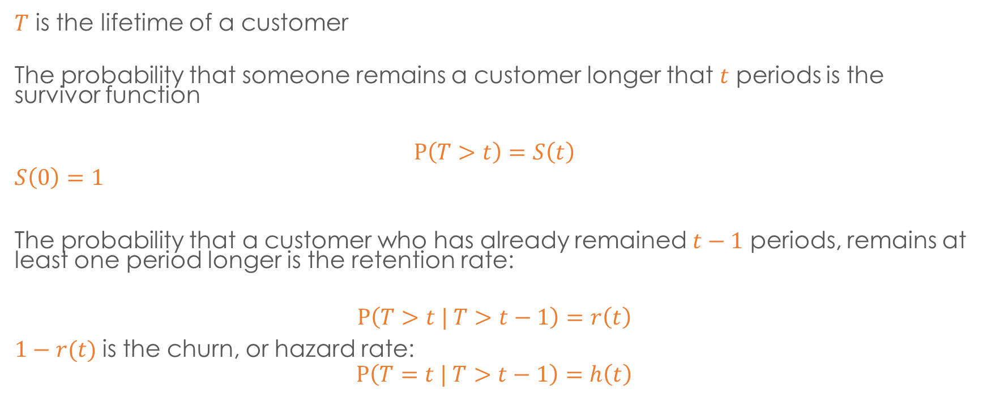
Retention rate and survivor function
$T$ is the lifetime of a customer
The probability that someone remains a customer longer that $t$ periods is the survivor function
$$P\left(T>t\right)=S\left(t\right)$$
$$S\left(0\right)=1$$
The probability that a customer who has already remained $t−1$ periods, remains at least one period longer is the retention rate:
$$P\left(T>t | T>t−1\right)=r\left(t\right)$$
$1−r(t)$is the churn, or hazard rate:
$$P\left(T=t | T>t−1\right)=h\left(t\right)$$
Notes:
Want to predict how long a customer will live
Two ways: unconditional and conditional

Slide 11
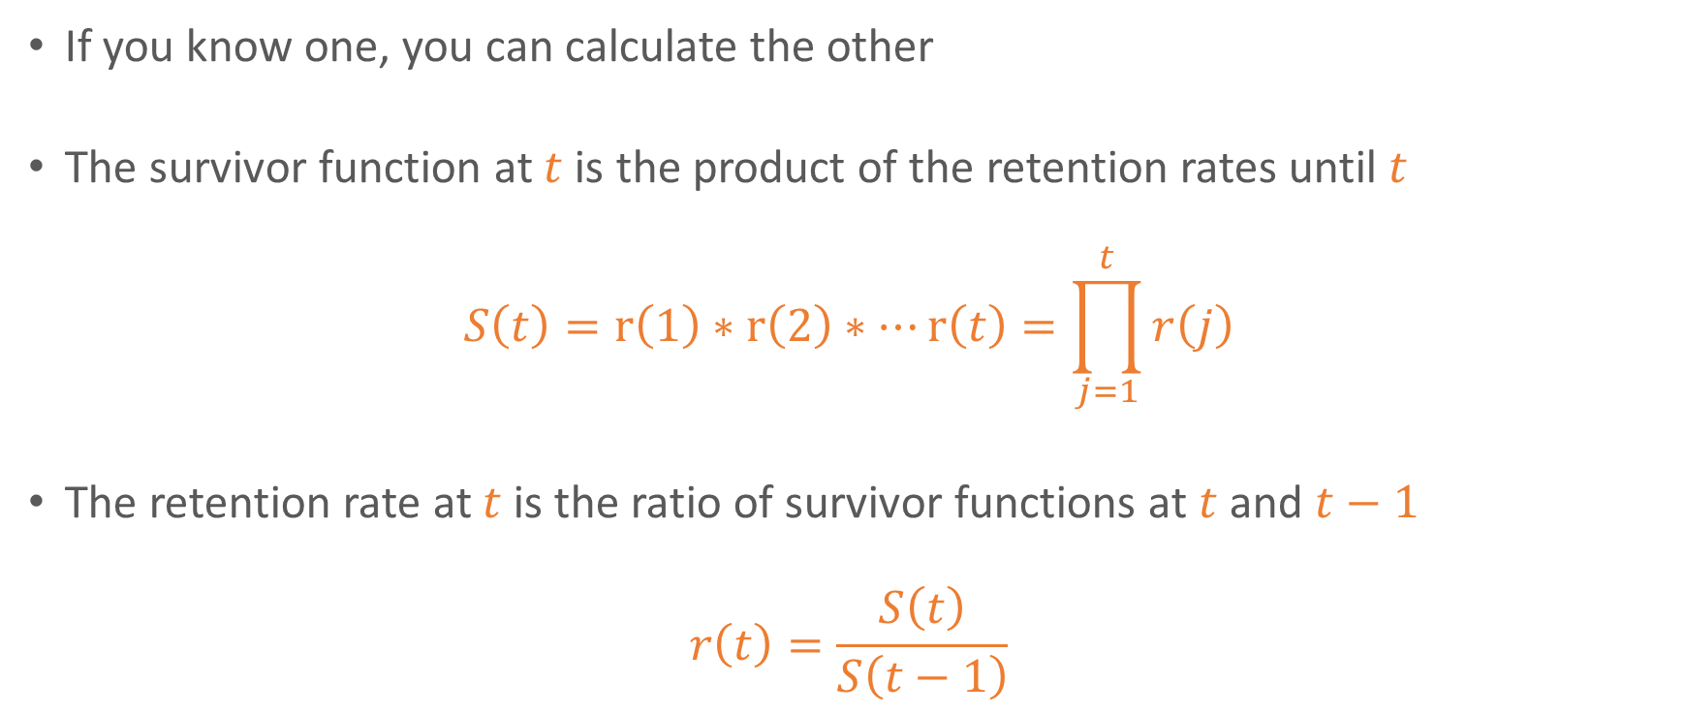
Retention rate and survivor function
If you know one, you can calculate the other
The survivor function at $t$is the product of the retention rates until $t$
$$S\left(t\right)=r\left(1\right)∗r\left(2\right)∗…r\left(t\right)=\prod_{j=1}^{t}{r\left(j\right)}$$
The retention rate at $t$is the ratio of survivor functions at $t$ and $t−1$
$$r\left(t\right)=\frac{S\left(t\right)}{S\left(t−1\right)}$$

Slide 12
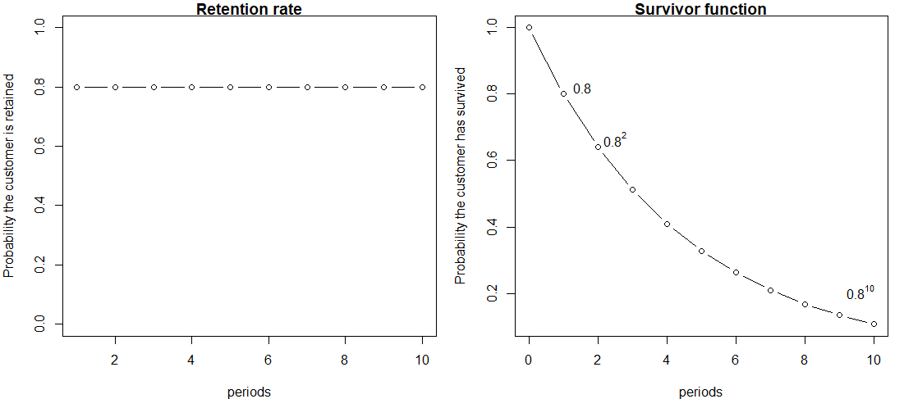
The most basic model is to say the retention rate is constant each period. Here we set $r\left(t\right)=0.8$

Slide 13
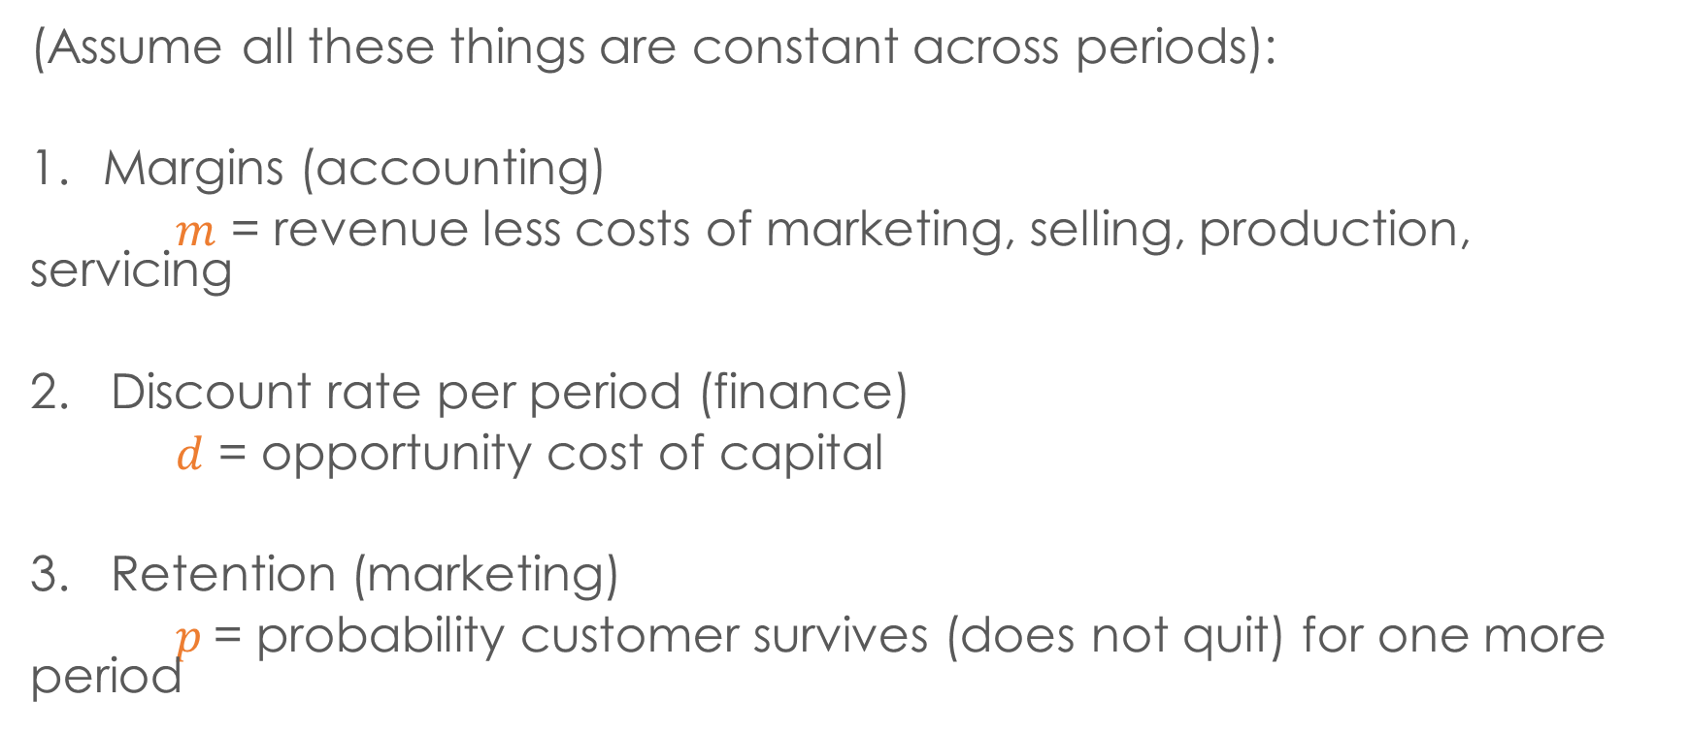
CLV geometric model
(Assume all these things are constant across periods):
Margins (accounting)
$m$ = revenue less costs of marketing, selling, production, servicing
2. Discount rate per period (finance)
$d$ = opportunity cost of capital
3. Retention (marketing)
$p$= probability customer survives (does not quit) for one more period
Notes:
Key source of uncertainty in CLV models: how long will customer remain?

Slide 14




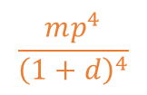




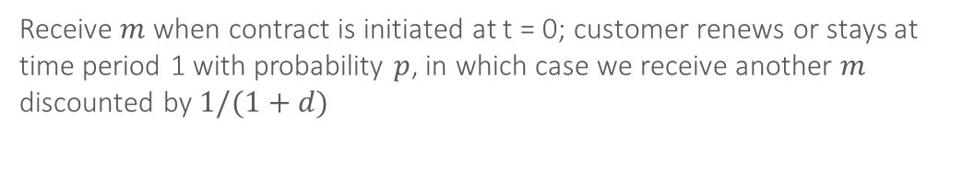
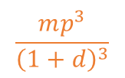









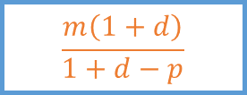
CLV geometric model: the formula
E[CLV]=
$$m$$
+
$$\frac{mp}{1+d}$$
+
$$\frac{mp^{2}}{{\left(1+d\right)}^{2}}$$
+
$$\frac{mp^{3}}{{\left(1+d\right)}^{3}}$$
$$\frac{mp^{4}}{{\left(1+d\right)}^{4}}$$
$$\frac{m\left(1+d\right)}{1+d−p}$$
A x B x C
+
=
…
A
Discounted to Present
$$1/(1+d)$$
$$1/{\left(1+d\right)}^{2}$$
$$1/{\left(1+d\right)}^{3}$$
$$1/{\left(1+d\right)}^{4}$$
B
Prob. cust. survives past t: $S(t)$
$$p$$
$p^{2}$
$$p^{3}$$
$$p^{4}$$
C
Margin
$$m$$
$$m$$
$$m$$
$$m$$
$$m$$
…
3
Time (0 is present)
0
2
4
1
Receive $m$ when contract is initiated at t = 0; customer renews or stays at time period 1 with probability $p$, in which case we receive another $m$ discounted by $1/(1+d)$

Slide 15
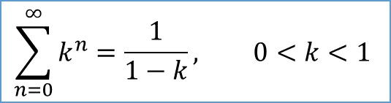
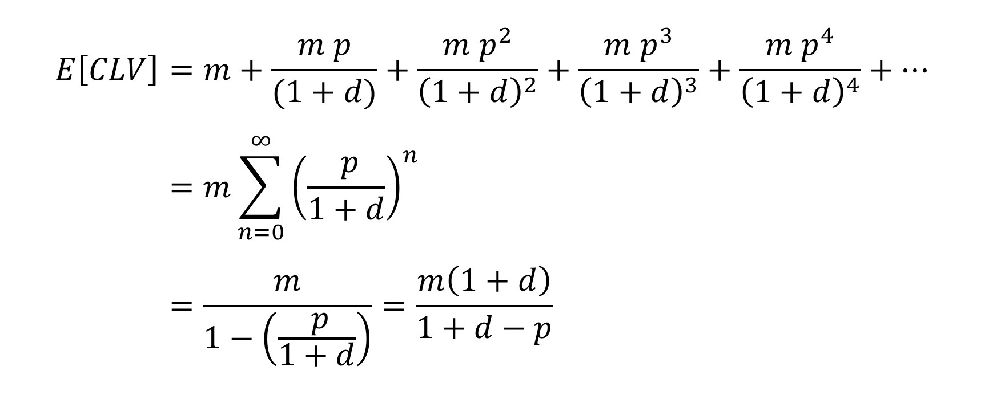
CLV calculations
$$E\left[CLV\right]=m+\frac{m p}{(1+d)}+\frac{m p^{2}}{{\left(1+d\right)}^{2}}+\frac{m p^{3}}{{\left(1+d\right)}^{3}}+\frac{m p^{4}}{{\left(1+d\right)}^{4}}+… \\ =m\sum_{n=0}^{∞}{{\left(\frac{ p}{1+d}\right)}^{n}} \\ =\frac{m}{1−\left(\frac{ p}{1+d}\right)}=\frac{m\left(1+d\right)}{1+d−p}$$
Geometric series
$$\sum_{n=0}^{∞}{k^{n}}=\frac{1}{1−k}, 0<k<1$$

Slide 16

Example: $m$= 100, $p$ = 0.80, $d$ = 0.10
E[CLV]=
100
+
72
+
53
+
38
+
28
…
=
367
$$m$$
+
$$\frac{mp}{1+d}$$
+
$$\frac{mp^{2}}{{\left(1+d\right)}^{2}}$$
+
$$\frac{mp^{3}}{{\left(1+d\right)}^{3}}$$
$$\frac{mp^{4}}{{\left(1+d\right)}^{4}}$$
$$\frac{m\left(1+d\right)}{1+d−p}$$
A x B x C
+
=
…
A
Discounted to Present
$$1/(1+d)$$
$$1/{\left(1+d\right)}^{2}$$
$$1/{\left(1+d\right)}^{3}$$
$$1/{\left(1+d\right)}^{4}$$
B
Prob. cust. survives past t: $S(t)$
$$p$$
$p^{2}$
$$p^{3}$$
$$p^{4}$$
C
Margin
$$m$$
$$m$$
$$m$$
$$m$$
$$m$$
…
3
Time (0 is present)
0
2
4
1
Expected customer lifetime value of this customer is €367

Slide 17
CLV vs. residual lifetime value (RLV)
CLV = for a not-yet-acquired customer, from first purchase
RLV = Residual Lifetime Value of already existing customer, including future purchases
E.g., what’s the value of a customer who with an “age” of 3 (3 years as a customer)?

Slide 18

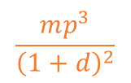


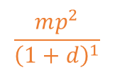

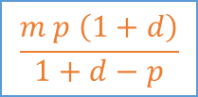
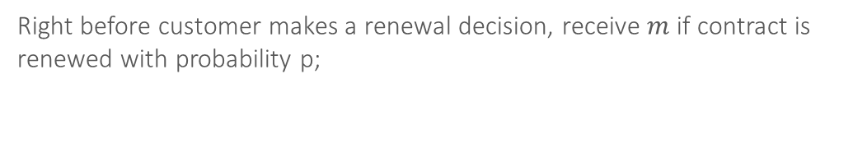

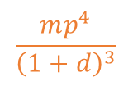

RLV: right before next renewal
$$mp$$
+
$$\frac{mp^{2}}{{\left(1+d\right)}^{1}}$$
+
$$\frac{mp^{3}}{{\left(1+d\right)}^{2}}$$
$$\frac{mp^{4}}{{\left(1+d\right)}^{3}}$$
$$\frac{m p \left(1+d\right)}{1+d−p}$$
A x B x C
+
=
…
present
A
Discounted to Present
$$1/{\left(1+d\right)}^{1}$$
$$1/{\left(1+d\right)}^{2}$$
$$1/{\left(1+d\right)}^{3}$$
B
Prob. cust. survives past t: $S(t)$
$$p$$
$p^{2}$
$$p^{3}$$
$$p^{4}$$
C
Margin
$$m$$
$$m$$
$$m$$
$$m$$
…
t+2
Time (t is present)
t-1
t+1
t+3
t*
history
future
Right before customer makes a renewal decision, receive $m$ if contract is renewed with probability p;

Slide 19



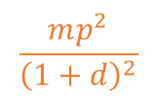


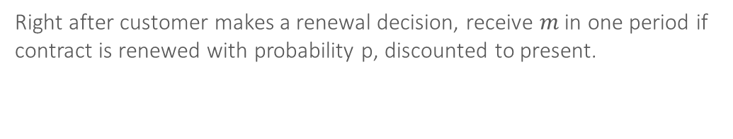



RLV: right after renewal
$$\frac{mp}{{\left(1+d\right)}^{1}}$$
+
$$\frac{mp^{2}}{{\left(1+d\right)}^{2}}$$
+
$$\frac{mp^{3}}{{\left(1+d\right)}^{3}}$$
$$\frac{mp^{4}}{{\left(1+d\right)}^{4}}$$
$$\frac{m p }{1+d−p}$$
A x B x C
+
=
…
present
A
Discounted to Present
$$1/{\left(1+d\right)}^{1}$$
$$1/{\left(1+d\right)}^{2}$$
$$1/{\left(1+d\right)}^{3}$$
$$1/{\left(1+d\right)}^{4}$$
B
Prob. cust. survives past t: $S(t)$
$$p$$
$p^{2}$
$$p^{3}$$
$$p^{4}$$
C
Margin
$$m$$
$$m$$
$$m$$
$$m$$
…
t+2
Time (t is present)
t-1
t+1
t+3
t*
history
future
Right after customer makes a renewal decision, receive $m$ in one period if contract is renewed with probability p, discounted to present.

Slide 20
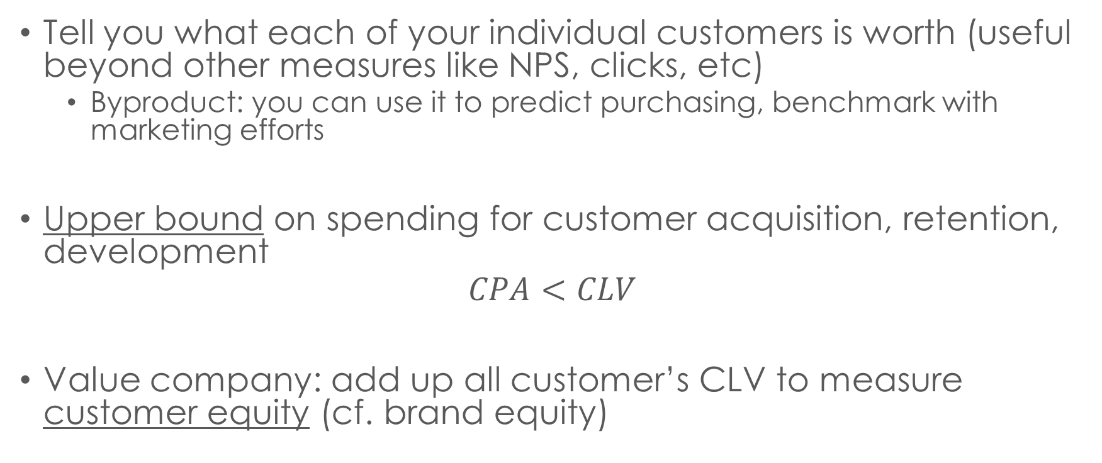
Uses of CLV
Tell you what each of your individual customers is worth (useful beyond other measures like NPS, clicks, etc)
Byproduct: you can use it to predict purchasing, benchmark with marketing efforts
Upper bound on spending for customer acquisition, retention, development
$$CPA<CLV$$
Value company: add up all customer’s CLV to measure customer equity (cf. brand equity)
Notes:
Netflix really worth it?

Slide 21
Forming segments based on CLV
Create segments: separate most valuable customers from everyone else, focus efforts
Platinum (5% of customers): 50% of total CLV
Gold (15%): 30% of total CLV
Silver (30%): 20% of total CLV
Lead (50%): 0% (or negative!) of total CLV

Slide 22
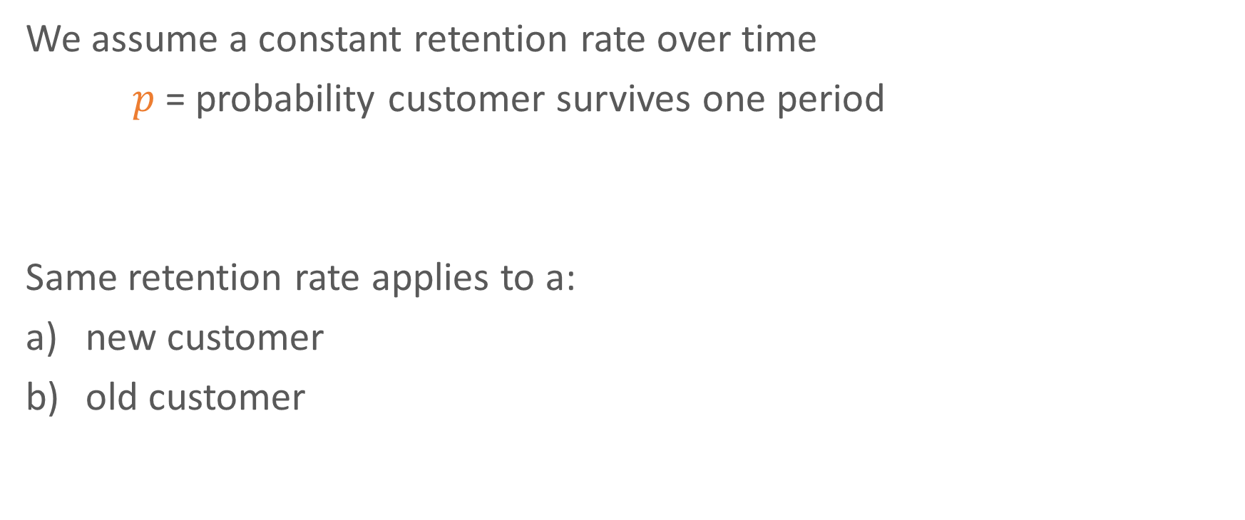
Valid assumption?
We assume a constant retention rate over time
$p$= probability customer survives one period
Same retention rate applies to a:
new customer
old customer

Slide 23
Can we test this?
Let’s take a cohort of customers who all started at the same time and record how long they remained a customer
Why study customers who started at the same time?
Cohort analysis
We can plot the survival of these customers

Slide 25
Why do cohort-level retention rates increase?
Notes:
Managers think: customers are becoming more loyal: our marketing or product is working.

Slide 26
Ruse of heterogeneity
Notes:
Retention rates increase when there is no dynamic, just heterogeneity.
A lot of stuff will look dynamic if you don’t properly account for heterogeneity.

Slide 27
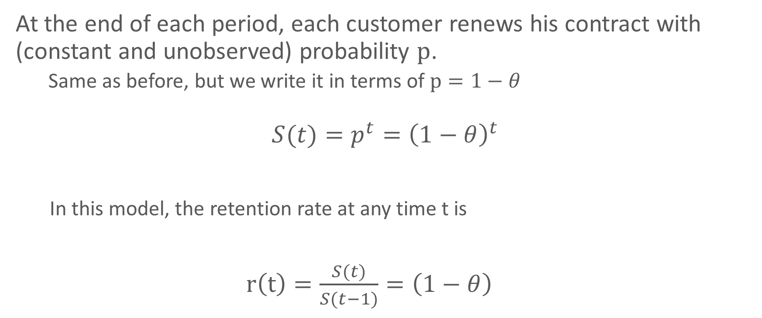
Review: geometric model
At the end of each period, each customer renews his contract with (constant and unobserved) probability $p$.
Same as before, but we write it in terms of $p=1−θ$
$$S(t)={p^{t}=\left(1−θ\right)}^{t}$$
In this model, the retention rate at any time t is
$r\left(t\right)=\frac{S(t)}{S(t−1)}=\left(1−θ\right)$
Fader and Hardie (2007), How to Project Customer Retention

Slide 28
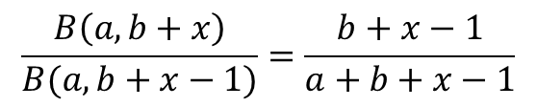
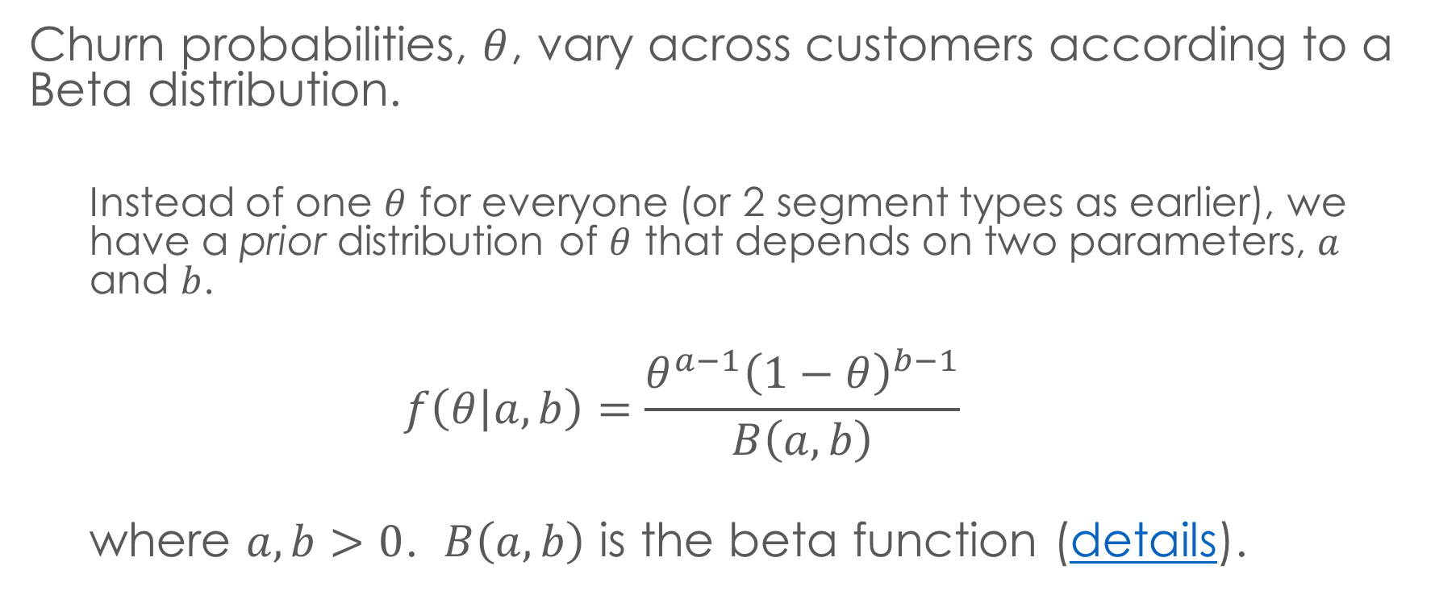
Prior distribution
Churn probabilities, $θ$, vary across customers according to a Beta distribution.
Instead of one $θ$ for everyone (or 2 segment types as earlier), we have a prior distribution of $θ$ that depends on two parameters, $a$ and $b$.
$$f\left(θ | a,b\right)=\frac{θ^{a−1}{\left(1−θ\right)}^{b−1}}{B\left(a,b\right)}$$
where $a,b>0$. $B\left(a,b\right)$ is the beta function (details).
We will use this formula later
Fader and Hardie (2007), How to Project Customer Retention
$$\frac{B\left(a,b+x\right)}{B(a,b+x−1)}=\frac{b+x−1}{a+b+x−1}$$
Notes:
Continuum;
Beta function just a number:

Slide 29




General shapes of the beta distribution
Spread out across whole range, but most likely to stay
$$b$$
Most customers fall within a certain range
$$1$$
Two types of customers:
extremely likely & unlikely
Spread out across whole range, but most likely to churn
$$1$$
$$a$$
Fader and Hardie (2007), How to Project Customer Retention
Notes:
$θ$ is the probability of churn.
These describe possible distributions of this probability among customers

Slide 30
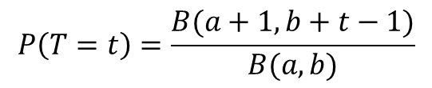
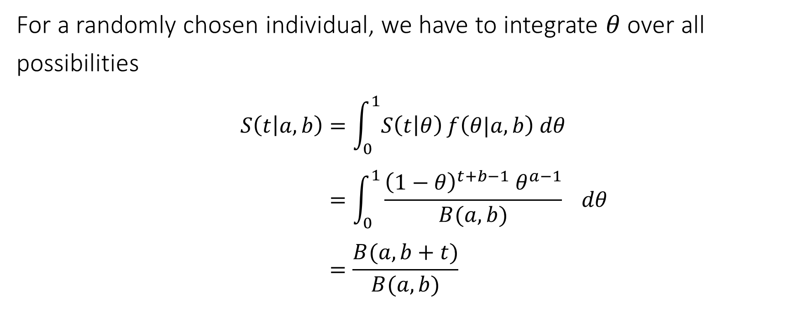
Shifted Beta-geometric model
For a randomly chosen individual, we have to integrate $θ$over all possibilities
$$S\left(t | a,b\right)=\int_{0}^{1}{S\left(t | θ\right)}f\left(θ|a,b\right) dθ \\ =\int_{0}^{1}{\frac{{\left(1−θ\right)}^{t+b−1} θ^{a−1}}{B(a,b)} } dθ \\ =\frac{B(a,b+t)}{B(a,b)}$$
Shifted geo. dist.
Beta dist.
$$P\left(T=t\right)=\frac{B(a+1,b+t−1)}{B(a,b)}$$

Slide 31

Retention rate in shifted beta-geometric model
$$r\left(t\right)=\frac{S(t)}{S(t−1)} \\ =\frac{B(a,b+t)/B(a,b)}{B(a,b+t−1)/B(a,b)} \\ =\frac{b+t−1}{a+b+t−1}$$

Slide 32
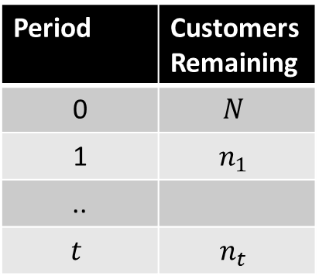



Likelihood
We have data on active customers starting at the first renewal opportunity
$$L\left(a,b\right)=P{\left(T=1\right)}^{{N−n}_{1}}×P{\left(T=2\right)}^{{n_{1}−n}_{2}}… ×P{\left(T=t\right)}^{n_{t−1}−n_{t}}×S{\left(t\right)}^{n_{t}}$$
Period | Customers Remaining
0 | $$N$$
1 | $$n_{1}$$
..
$$t$$ | $$n_{t}$$
$N−n_{1}$ customers quit in period 1
$n_{t}$ customers remaining in period t

Slide 33
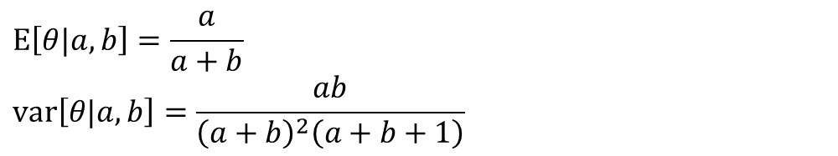


Two different groups
Two populations with the same mean, but different variance (green more than blue)
$$a=2.0, b=8.0$$
$$a=0.1, b=0.4$$
Beta distribution
$$\text{E}\left[θ|a,b\right]=\frac{a}{a+b}$$
$$\text{var}\left[θ|a,b\right]=\frac{ab}{{\left(a+b\right)}^{2}\left(a+b+1\right)}$$
https://en.wikipedia.org/wiki/Beta_distribution
Notes:
var = .0145 if a=2,b=8
Var = .1067 if a = .1, b=.4

Slide 34
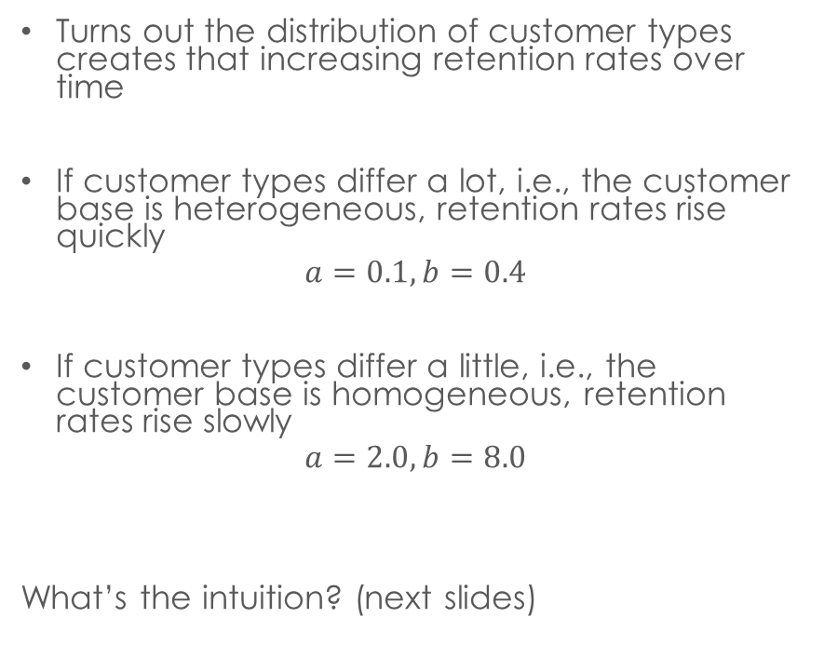


Implications for retention rate
Customer heterogeneity
Retention rate dynamics
Turns out the distribution of customer types creates that increasing retention rates over time
If customer types differ a lot, i.e., the customer base is heterogeneous, retention rates rise quickly
$$a=0.1, b=0.4$$
If customer types differ a little, i.e., the customer base is homogeneous, retention rates rise slowly
$$a=2.0, b=8.0$$
What’s the intuition? (next slides)
$$a=0.1, b=0.4$$
$$a=2.0, b=8.0$$

Slide 35

1000 customers acquired
$$S(0)=1.000$$
1000 draws from a Beta distribution where $a=2, b=8$

Slide 36
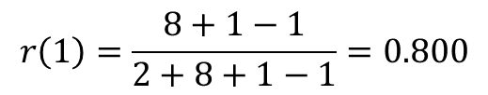

Period 1
Where does this distribution come from? (appendix)
Expect 200 to quit, leaving 800
$$r\left(1\right)=\frac{8+1−1}{2+8+1−1}=0.800$$
$$S\left(1\right)=0.800×1.000$$
800 draws from a Beta distribution where $a^{∗}=2, b^{∗}=b+1=9$

Slide 37
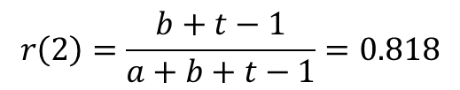

Period 2
Expect 145 to quit, leaving 655
$$r\left(2\right)=\frac{b+t−1}{a+b+t−1}=0.818$$
$$S\left(2\right)=0.818×0.800 =0.655$$
655 draws from a Beta distribution where $a^{∗}=2, b^{∗}=b+2=10$

Slide 38
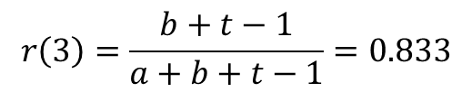
Period 3
Expect 110 to quit, leaving 545
$$r\left(3\right)=\frac{b+t−1}{a+b+t−1}=0.833$$
$$S\left(3\right)=0.833×0.818×0.800 =0.545$$
545 draws from a Beta distribution where $a^{∗}=2, b^{∗}=b+3=10$

Slide 39

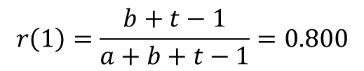
Compare to more heterogeneous customer base, period 1
cut off, max=568
$$a=0.1, b=0.4$$
Model parameters for high heterogeneity
$$r\left(1\right)=\frac{b+t−1}{a+b+t−1}=0.800$$
800 draws from a Beta distribution where $a^{∗}=0.1, b^{∗}=0.1+1=1.1$

Slide 40
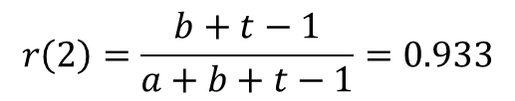
period 2
cut off, max=567
$$r\left(2\right)=\frac{b+t−1}{a+b+t−1}=0.933$$
747 draws from a Beta distribution where $a^{∗}=0.1, b^{∗}=0.1+2=2.1$

Slide 41
Concepts
Customer heterogeneity
Retention rate dynamics
Retention rates slope upward even if customers propensity to churn stays the same over time.
Why?
High-churn customers drop out early
Sorting effect in a heterogeneous population
Remaining customers have lower churn probabilities
Happens more quickly the more heterogeneity there is
Ignoring this will bias your CLV estimates downwards

Slide 42
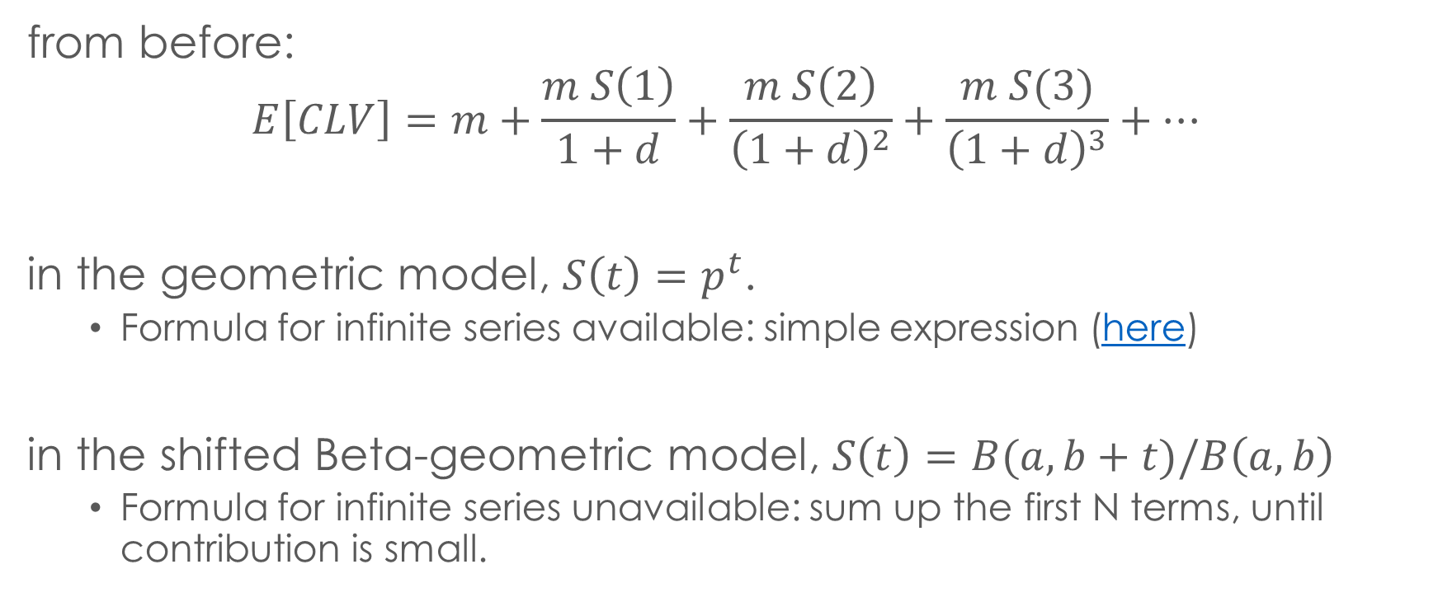
CLV with the BG model
from before:
$$E\left[CLV\right]=m+\frac{m S\left(1\right)}{1+d}+\frac{m S\left(2\right)}{{\left(1+d\right)}^{2}}+\frac{m S(3)}{{\left(1+d\right)}^{3}}+…$$
in the geometric model, $S\left(t\right)=p^{t}$.
Formula for infinite series available: simple expression (here)
in the shifted Beta-geometric model, $S\left(t\right)=B(a,b+t)/B\left(a,b\right)$
Formula for infinite series unavailable: sum up the first N terms, until contribution is small.

Slide 43
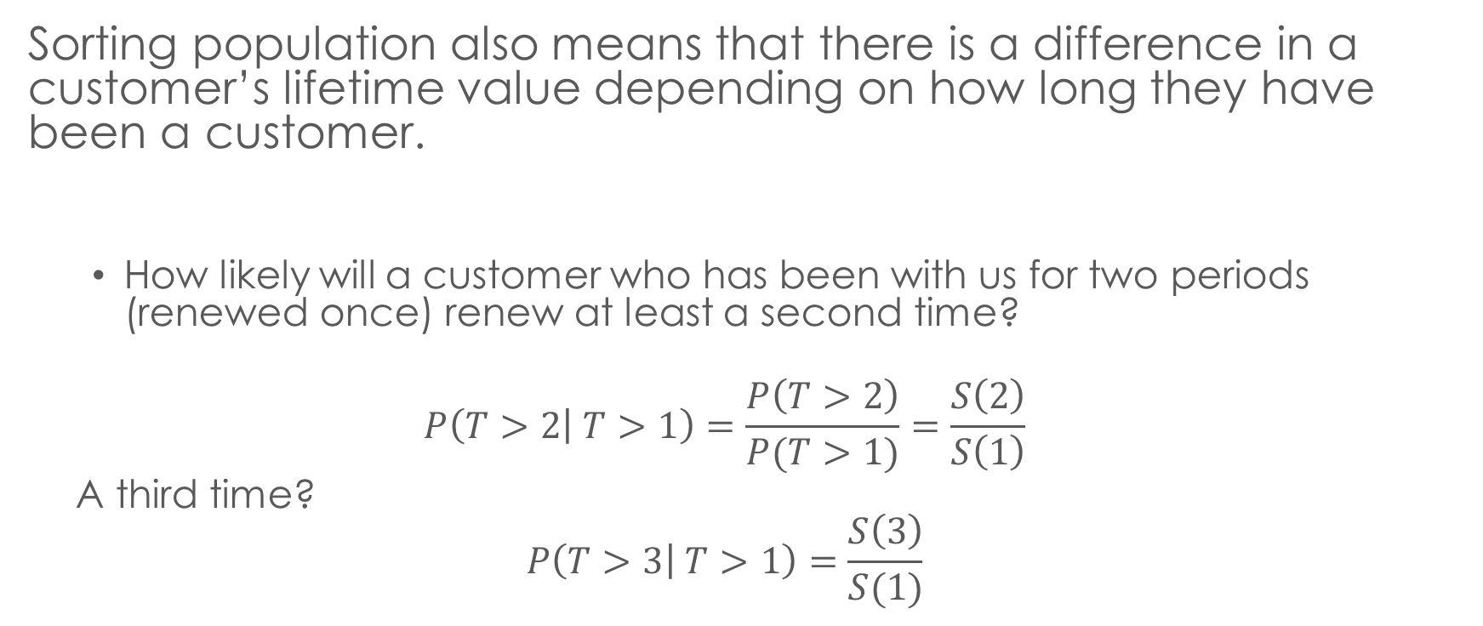
RLV under the BG model
Sorting population also means that there is a difference in a customer’s lifetime value depending on how long they have been a customer.
How likely will a customer who has been with us for two periods (renewed once) renew at least a second time?
$$P\left(T>2 | T>1\right)=\frac{P\left(T>2\right)}{P(T>1)}=\frac{S\left(2\right)}{S\left(1\right)}$$
A third time?
$$P\left(T>3 | T>1\right)=\frac{S\left(3\right)}{S(1)}$$

Slide 44
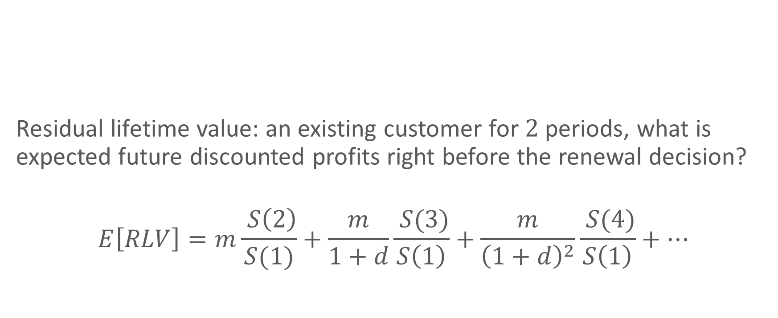
RLV
Residual lifetime value: an existing customer for $2$ periods, what is expected future discounted profits right before the renewal decision?
$$E\left[RLV\right]=m\frac{ S\left(2\right)}{S(1)}+\frac{m}{1+d}\frac{ S(3)}{S\left(1\right)}+\frac{m}{{\left(1+d\right)}^{2}}\frac{ S(4)}{S\left(1\right)}+…$$
3
0
2
1

Slide 45
Customer Lifetime Value
CLV is a forward looking metric: different models give different results
Geometric model: constant retention over time
Shifted Beta-geometric: increasing
Dynamic patterns can arise from simple heterogeneity
Not accounting for retention rate increases will bias CLV and RLV calculations downward.

Slide 46
Appendix

Slide 47
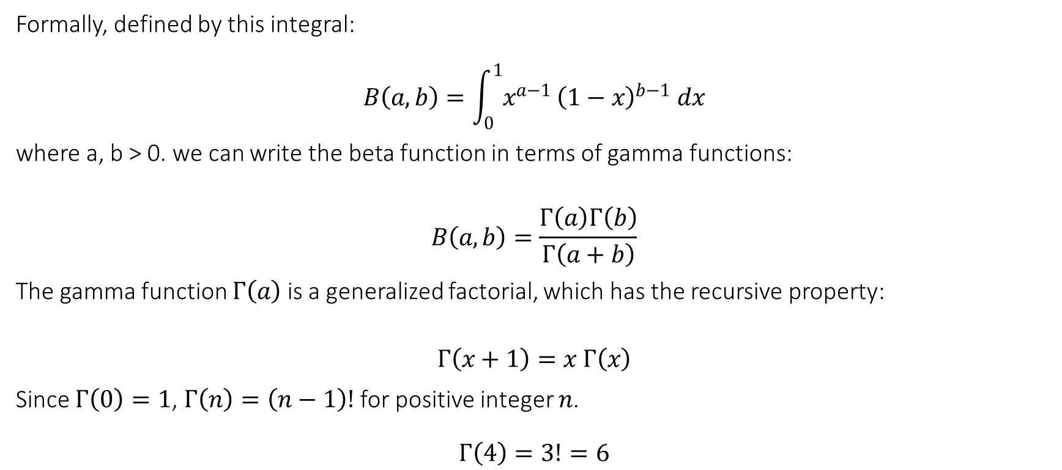
Aside: beta function
Formally, defined by this integral:
$$B\left(a,b\right)=\int_{0}^{1}{x^{a−1}}{\left(1−x\right)}^{b−1} dx$$
where a, b > 0. we can write the beta function in terms of gamma functions:
$$B\left(a,b\right)=\frac{Γ\left(a\right)Γ\left(b\right)}{Γ\left(a+b\right)}$$
The gamma function $Γ\left(a\right)$ is a generalized factorial, which has the recursive property:
$$Γ\left(x+1\right)=x Γ\left(x\right)$$
Since $Γ\left(0\right)=1$, $Γ\left(n\right)=\left(n−1\right)!$ for positive integer $n$.
$$Γ\left(4\right)=3!=6$$

Slide 48


Bayes Rule: updating the distribution of $θ$
$$P\left(B | A\right)=\frac{P\left(A | B\right)P\left(B\right)}{P(A)} \\ f\left(θ | T>t\right)=\frac{S\left(t | θ\right)f\left(θ | a,b\right)}{\int{S\left(t | θ\right)f\left(θ | a,b\right) dθ}} \\ =\frac{{\left(1−θ\right)}^{t+b−1}θ^{a−1}/B(a,b)}{B(a,b+t)/B(a,b)} \\ =\frac{{θ^{a−1}\left(1−θ\right)}^{t+b−1}}{B(a,b+t)}$$
This is just a beta distribution with $a^{∗}=a$ and $b^{∗}=b+t$

